Slide 1
Recent Security Techniques in (Non-Volatile) Main Memories
CDA5220 Semester Project
Ardhi Yudha, Maryam Babaie
Fall 2019

Slide 2
Selected Papers
Anubis: Low-Overhead and Practical Recovery Time for Secure Non-Volatile Memories (ISCA 2019)
Triad-NVM: Persistency for Integrity-Protected and Encrypted Non-Volatile Memories (ISCA 2019)
Morphable Counters: Enabling Compact Integrity Trees for Low-Overhead Secure Memories (MICRO 51)
Improving the Performance and Endurance of Encrypted Non-volatile Main Memory through Deduplicating Writes (MICRO 51)
Osiris: A Low-Cost Mechanism to Enable Restoration of Secure Non-Volatile Memories (MICRO 51)

Slide 3
Improving the Performance and Endurance of Encrypted Non-volatile Main Memory through Deduplicating Writes (Micro 2018)

Slide 4
Problem Description
Endurance of NVM
–limited write endurance [107~109 for PCM, 108~1012 for ReRAM]
– Writes have much higher latency than reads
– Write reduction matters for NVM
Security of NVM
– NVM non-volatility makes it vulnerable to stolen main memory attack
– Memory encryption matters for NVM
However, memory encryption techniques increases writes to NVM.

Slide 5
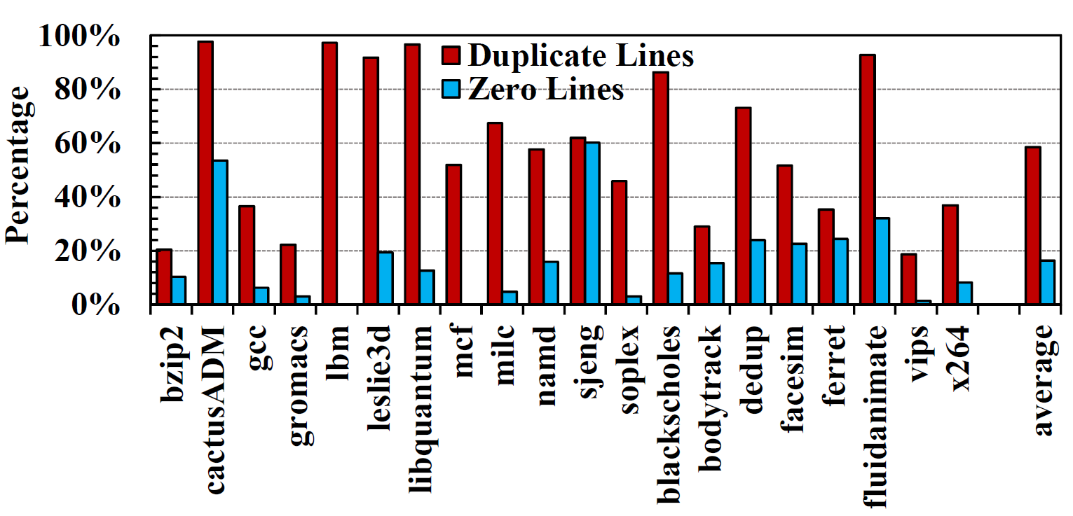
Motivation
Improving performance and endurance of encrypted NVM through deduplicating entire-line writes.
18.6% to 98.4% across the 20 applications duplicates exist in real-world applications.
(The first 12 applications from the SPEC CPU2006 and the following 8 applications from the PARSEC.)

Slide 6
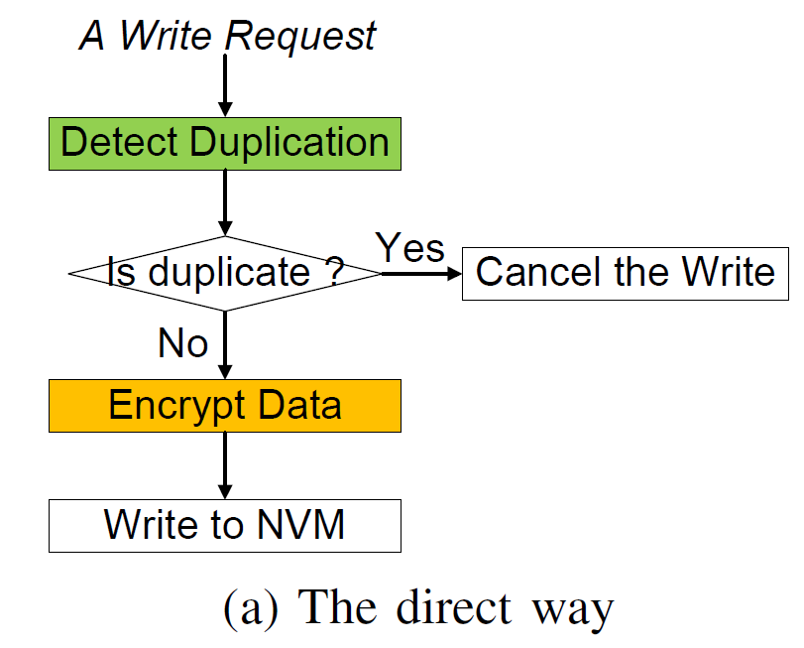
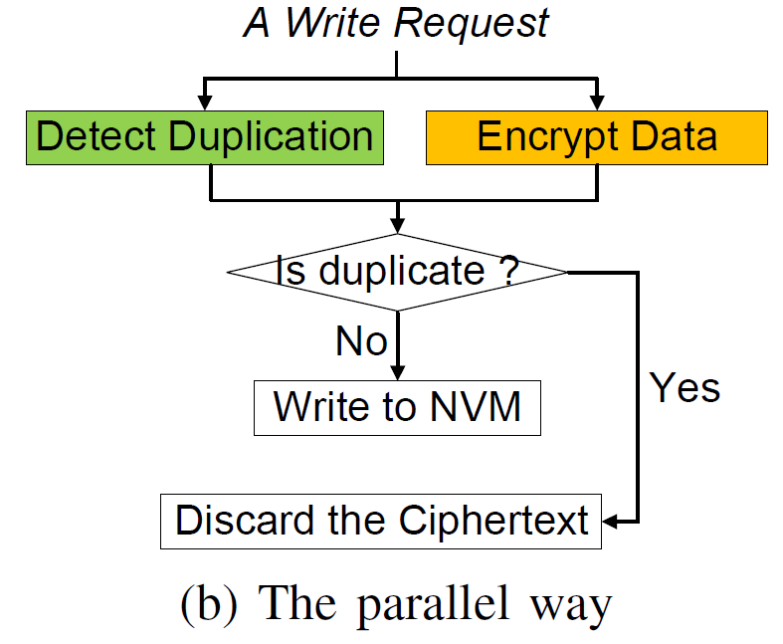
Solution: DeWrite
Serial execution
inefficient for non-duplicate writes
Unnecessary encryption
inefficient for duplicate writes
Prediction
Policy
duplicate
non duplicate

Slide 7
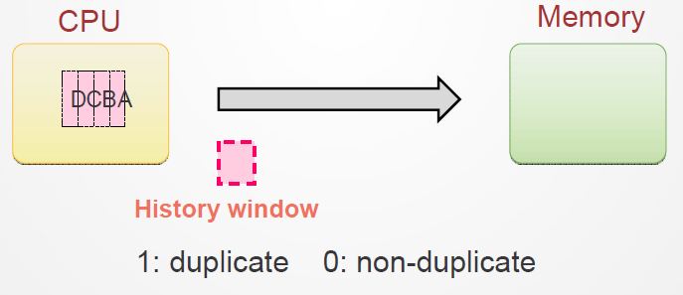
Prediction Policy
If the most recent memory writes are mostly duplicate (or non-duplicate), the next memory write is predicted to be duplicate (or non-duplicate). (temporal locality)
3 bits window history

Slide 8
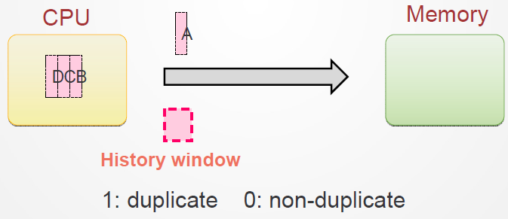
Prediction Policy
If the most recent memory writes are mostly duplicate (or non-duplicate), the next memory write is predicted to be duplicate (or non-duplicate). (temporal locality)
3 bits window history

Slide 9
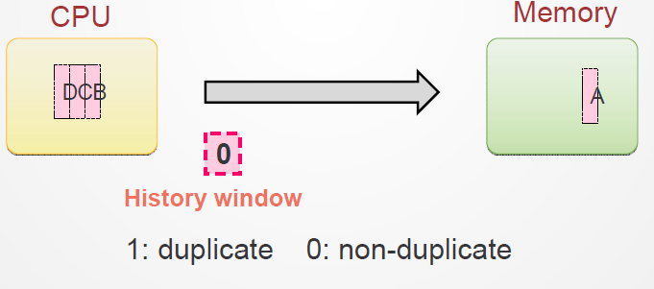
Prediction Policy
If the most recent memory writes are mostly duplicate (or non-duplicate), the next memory write is predicted to be duplicate (or non-duplicate). (temporal locality)
3 bits window history

Slide 10
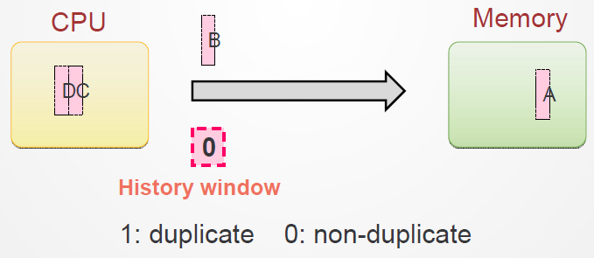
Prediction Policy
If the most recent memory writes are mostly duplicate (or non-duplicate), the next memory write is predicted to be duplicate (or non-duplicate). (temporal locality)
3 bits window history

Slide 11
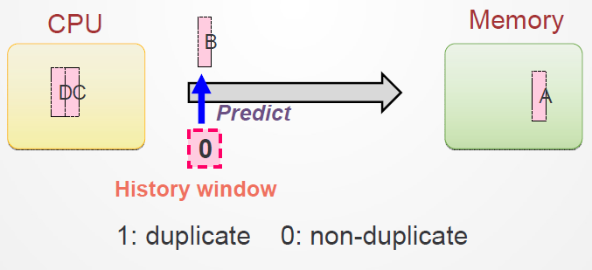
Prediction Policy
If the most recent memory writes are mostly duplicate (or non-duplicate), the next memory write is predicted to be duplicate (or non-duplicate). (temporal locality)
3 bits window history

Slide 12
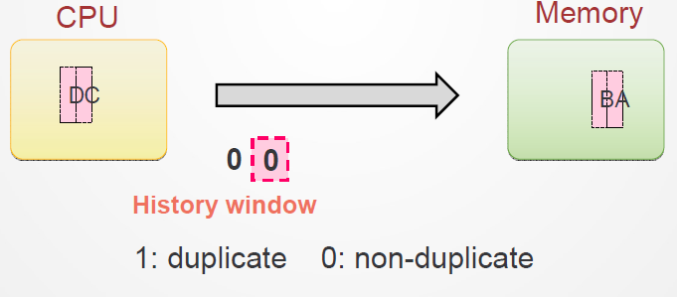
Prediction Policy
If the most recent memory writes are mostly duplicate (or non-duplicate), the next memory write is predicted to be duplicate (or non-duplicate). (temporal locality)
3 bits window history

Slide 13
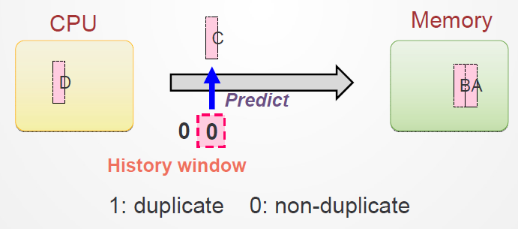
Prediction Policy
If the most recent memory writes are mostly duplicate (or non-duplicate), the next memory write is predicted to be duplicate (or non-duplicate). (temporal locality)
3 bits window history

Slide 14
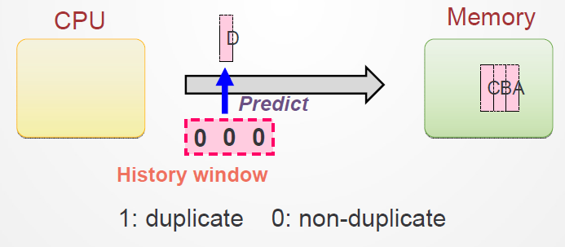
Prediction Policy
If the most recent memory writes are mostly duplicate (or non-duplicate), the next memory write is predicted to be duplicate (or non-duplicate). (temporal locality)
3 bits window history
The use of the three most recent memory writes has on average 93.6% accuracy.

Slide 15
Analysis
Performance improvement at the cost of a read
NVM Assymetry in Rd/Wr Latency
Read (20-70 ns) Write (150-220 ns)
Removing the write latency off from the critical path
Speeding up read and nonduplicate write requests by reducing their waiting time.

Slide 16
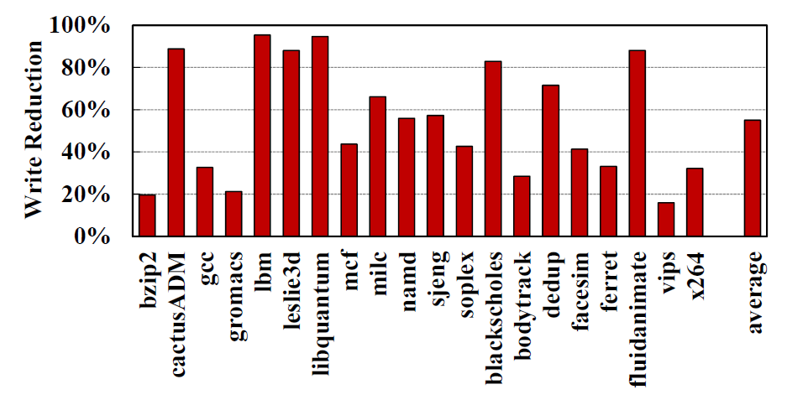
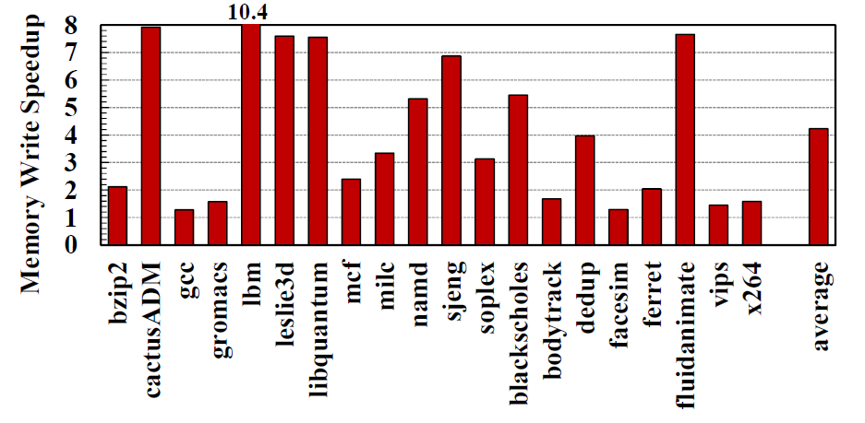
Evaluation
DeWrite VS the traditional secure NVM system that uses the counter mode encryption without deduplication.
DeWrite reduces 54% writes to secure NVM on average
DeWrite speeds up NVM writes by 4.2X on average

Slide 17
Morphable Counters: Enabling Compact Integrity Trees For Low-Overhead Secure Memories (Micro 2018)

Slide 18
Problem Description
Security for main memory is a vital against physical attacks
Securing memory requires security metadata on each data access.
data encryption
counters
verifying data integrity
cryptographic hash of data (MAC)
To prevent replay attacks
several memory accesses to traverse integrity tree
These accesses stress the memory bandwidth causing performance slowdown.

Slide 19
Motivation
Integrity
Tree
Split Counters
64 x 7-bit minor counters
Major
Counter
C1
C2
C3
.
.
.
.
.
.
.
.
.
C64
Major | Minor = Counter
Less Counter Overflow
Less encryption metadata overhead (read/write update of counters)
More overhead in tree traversal

Slide 20
Motivation
Split Counters
Integrity
Tree
128 x 3-bit minor counters
Major
Counter
C1
C2
C3
.
.
.
.
.
.
.
.
.
C128
Major | Minor = Counter
Frequent Counter Overflow
More encryption metadata overhead (read/write update of counters)
Less overhead in tree traversal

Slide 21
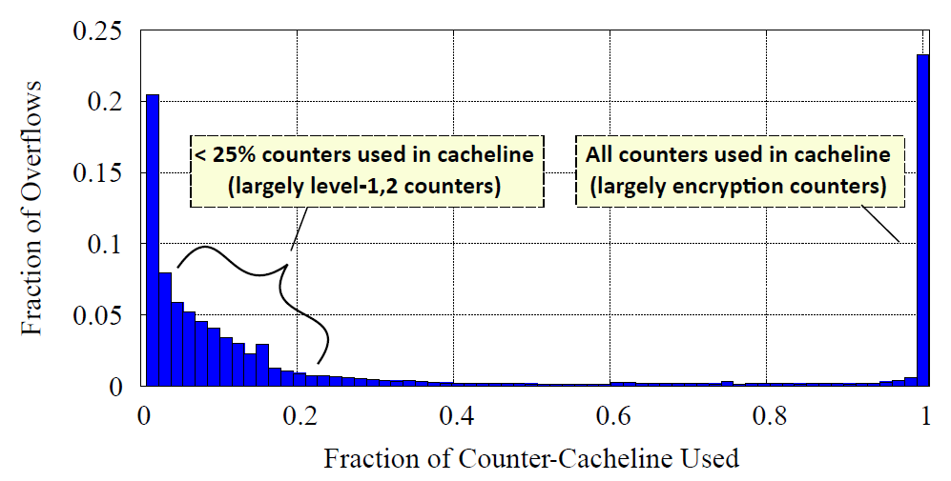
Motivation
Our analysis of overflowing counters shows that applications either use less than a quarter of the counters in a cacheline or use all the counters in a cacheline.

Slide 22
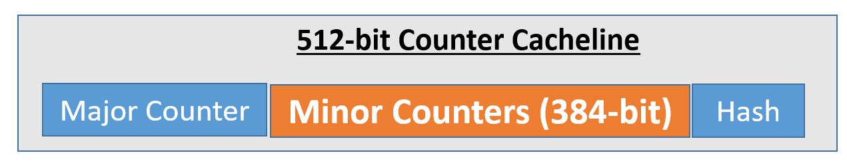
Morphable Counters
Compress Zero Counters: when few counters non-zero, allocate bits only to them.

Slide 23
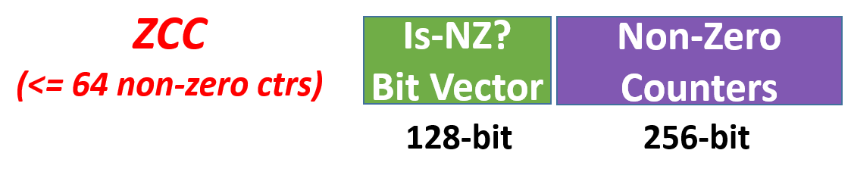
Morphable Counters
Compress Zero Counters: when few counters non-zero, allocate bits only to them.

Slide 24
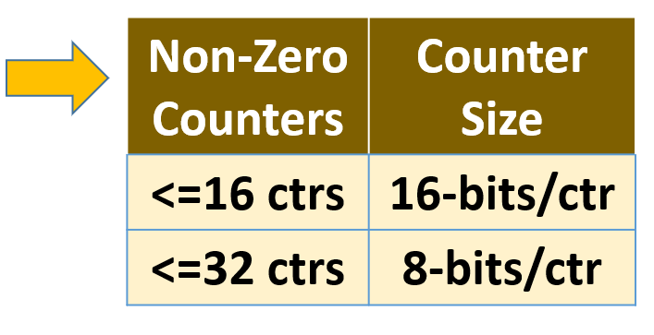
Morphable Counters
Compress Zero Counters: when few counters non-zero, allocate bits only to them.

Slide 25
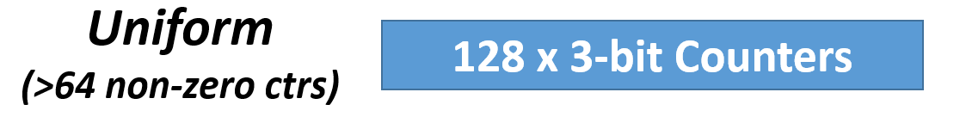
Morphable Counters
Compress Zero Counters: when few counters non-zero, allocate bits only to them.

Slide 26
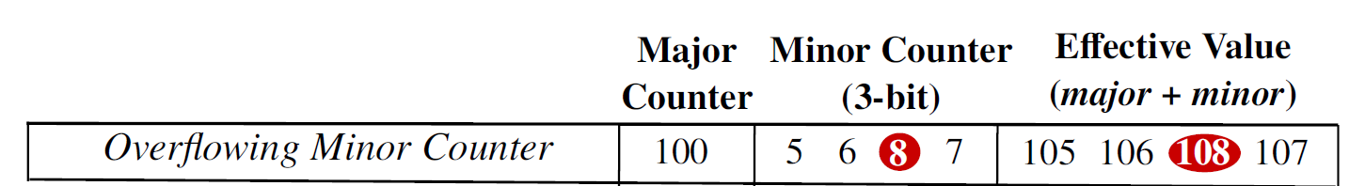
Overflow Handling
Instead of conventional (Major II Minor)

Slide 27
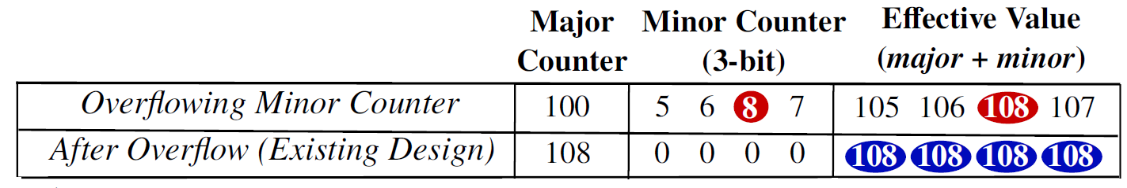
Overflow Handling
Instead of conventional (Major II Minor)
Counters changed
Re-encryption needed

Slide 28
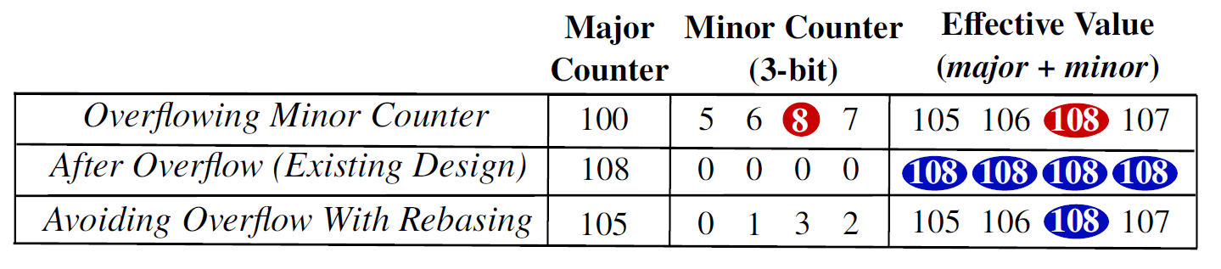
Overflow Handling
Instead of conventional (Major II Minor)
+5
-5
No change
No re-encryption

Slide 29
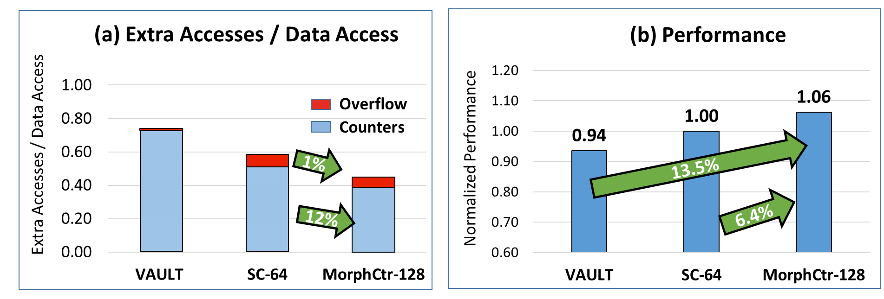
Evaluation
VAULT: uses a variable arity of split counters (16 or 32 counters per cacheline) to limit counter overflows, resulting in a large integrity tree (8.5MB size, 6 levels).
Config: 4 Cores, 8MB LLC, 16GB Secure Memory, 128KB Dedicated Counter Cache

Slide 30
Rest of the Papers
Osiris: A Low-Cost Mechanism to Enable Restoration of Secure Non-Volatile Memories (MICRO 51)
Anubis: Low-Overhead and Practical Recovery Time for Secure Non-Volatile Memories (ISCA 2019)
Triad-NVM: Persistency for Integrity-Protected and Encrypted Non-Volatile Memories (ISCA 2019)

Slide 31
Problem
Normal
MT ROOT
MT Block
MT Cache
Counter Block
Counter Cache
LLC
Memory
Controller
+
AES
Engine
Data Block
On-chip
Memory

Slide 32
Problem
Normal
Crash
MT ROOT
MT Block
MT ROOT
MT Block
MT Cache
MT Cache
Counter Block
X | X | V | V
V | V | V | V
Counter Cache
Counter Cache
LLC
LLC
V | V | V | V
V | V | V | V
V | V | V | V
V | V | V | V
Memory
Controller
+
AES
Engine
Memory
Controller
+
AES
Engine
Data Block
On-chip
Memory
On-chip
Memory

Slide 33
Problem
Normal
Crash
MT ROOT
MT Block
MT ROOT
MT Block
MT Cache
MT Cache
Counter Block
X | X | V | V
V | V | V | V
MISSMATCH
Incorrect Decryption
Counter Cache
Counter Cache
LLC
LLC
V | V | V | V
V | V | V | V
V | V | V | V
V | V | V | V
Memory
Controller
+
AES
Engine
Memory
Controller
+
AES
Engine
Data Block
On-chip
Memory
On-chip
Memory

Slide 34
Osiris: A Low-Cost Mechanism to Enable Restoration of Secure Non-Volatile Memories (Micro 2018)

Slide 35

Osiris
Goal : Provide a scheme to bridge the gap between performance and reliability of secure non-volatile memory due to counter persistency issue.
This Photo by Unknown author is licensed under CC BY-SA.

Slide 36
Osiris
Recover the counter using Error Correcting mechanism (ECC bits).
Error-correcting code (ECC) used for making sanity-check for encryption counter
Memory Controller writes a cache block to the memory it also calculcate its ECC. The tupple that will be written to memory will be :
{X, ECC(X)}

Slide 37
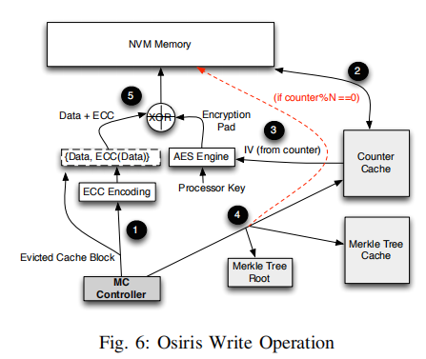
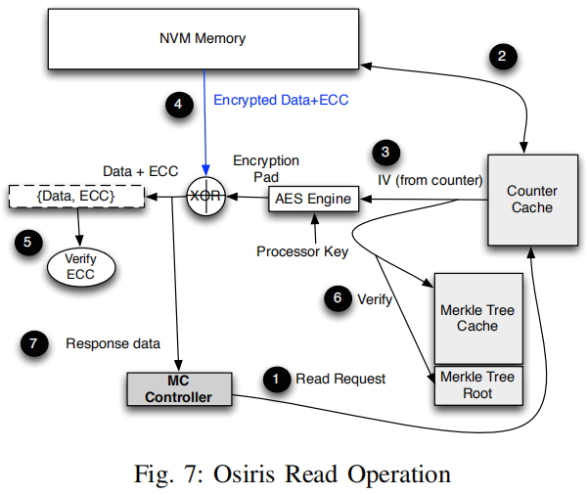
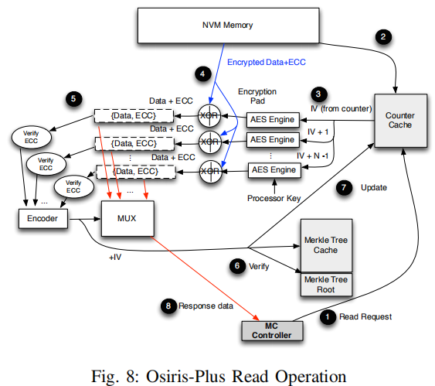
Osiris Operation

Slide 38
Anubis: Low-Overhead and Practical Recovery Time for Secure Non-Volatile Memories (ISCA 2019)

Slide 39

Anubis
This Photo by Unknown author is licensed under CC BY-NC-ND.

Slide 40
Anubis
Goal : Reducing recovery time i.e. merkle tree reconstruction
Root
Secure Boundary
Intermediate
Node
C
C
C
C
C
C
C
C

Slide 41
Anubis
The system needs to only rebuild affected parts of the tree
Root
Intermediate
Node
C
C
C
C
C
C
C
C

Slide 42
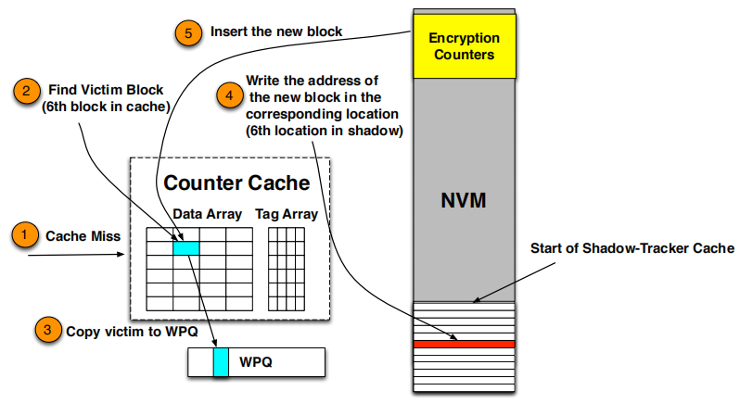
Anubis
Shadow Table

Slide 43
Triad-NVM: Persistency for Integrity-Protected and Encrypted Non-Volatile Memories (ISCA 2019)

Slide 44
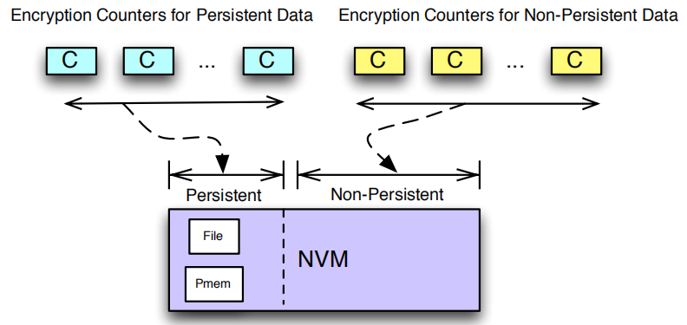
Triad-NVM
Goal : Triad-NVM tackles resilience, performance, recovering system with both persistent and non-persistent regions

Slide 45
Triad-NVM
Split Bonsai Merkle Tree (BMT) for persistent and non-persistent region (to avoid counter reuse)
Consistent with the separation of counters and MACs for the two region.

Slide 46
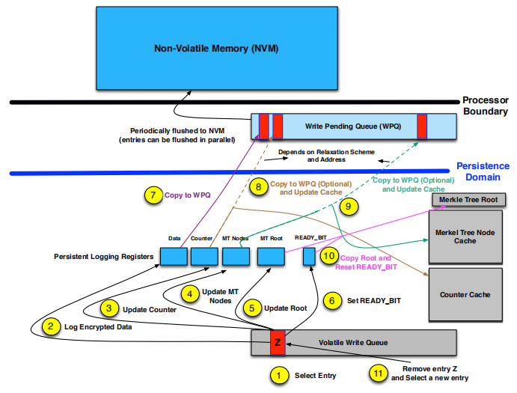
Triad-NVM
High-level overview of Write Operation on TriadNVM

Slide 47
Comparison & Analysis
Technique | Problem | Threat Model | Solution | Critique
Osiris | Recovery Counter | Physical access (bus snooping and stolen NVM) | Repurpose ECC bits | There is no area overhead
Anubis | Speedup the Merkle Tree reconstruction | Physical access (bus snooping and stolen NVM) | Create a shadow table for tracking the affected tree | Incurs high extra write for Intel SGX style Merkle Tree
Triad-NVM | tradeoff between recovery time and performance, and reduces the recovery time by persisting N levels of the MT | Physical access (bus snooping and stolen NVM) | Splitting the Merkle Tree | requires persisting multiple levels of the integrity tree
DeWrite | NVM limited Wr endurance when using encryption | Physical access (bus snooping and stolen NVM) | Parallelizing deduplication and encryption | They have assumed the baseline a very traditional counter-based encryption and they have not provided discussion on how their design will fit with commercial products like SGX.
Morph. Ctr | Counters overflow overhead | Physical access (replay attack) | Compress Zero Counters, Flexible in size, Make overflow less freq. | The paper does not discuss about how write propagation is done when the node in the cache is updated and how context switch affects it.
(General)
(General)
(General)
(App behaviour based)
(App behaviour based)
Notes:
This scheme does not immediately update the root. Once that node in the cache (one which is the most updated one in the cache and beyond which writes did not propagate last time) gets evicted, the parent node is incremented. Thus writes are propagated upward lazily relying on the assumption that such updates will be eventually

Slide 48
Questions?

